Slide 1
PRODUCT MANAGEMENT
Andy Acs
PDM8

Slide 2
AGENDA
How the Internet Works
Programming Languages & Terminology
Constraints & Solutions
Bringing It All Home

Slide 3
LEARNING GOALS
Define key terminology regarding creating digital products
Recognize common constraints and solutions that product managers face with digital products.

Slide 4
You don’t need to be an engineer, but you need to speak it.
DISCLAIMER!
Having a foundational understanding of how products are built is key to:
  Creating something that can realistically be built
  Building a relationship with engineers
  Understanding the implications of the decisions you make

Slide 5
DISCLAIMER!
YOU DON’T NEED TO BE AN ENGINEER, BUT YOU NEED TO speak it.
this lesson is just the beginning. YOU WILL NOT LEARN EVERYTHING YOU NEED TO KNOW BY THE END OF THIS LESSON.

Slide 6

HOW THE INTERNET WORKS
HOW DOES the internet WORK?

Slide 7


HOW THE INTERNET WORKS
ROUTER
MODEM
ISP
DNS
SERVERS
SCRIPTS

Slide 8
PROGRAMMING LANGUAGES
WHO HERE HAS SOME programming EXPERIENCE?

Slide 9
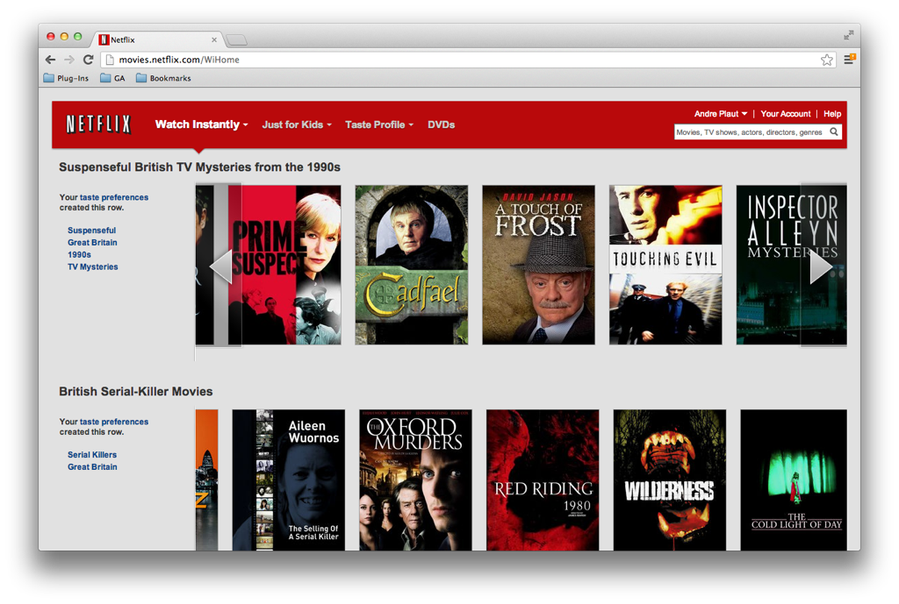
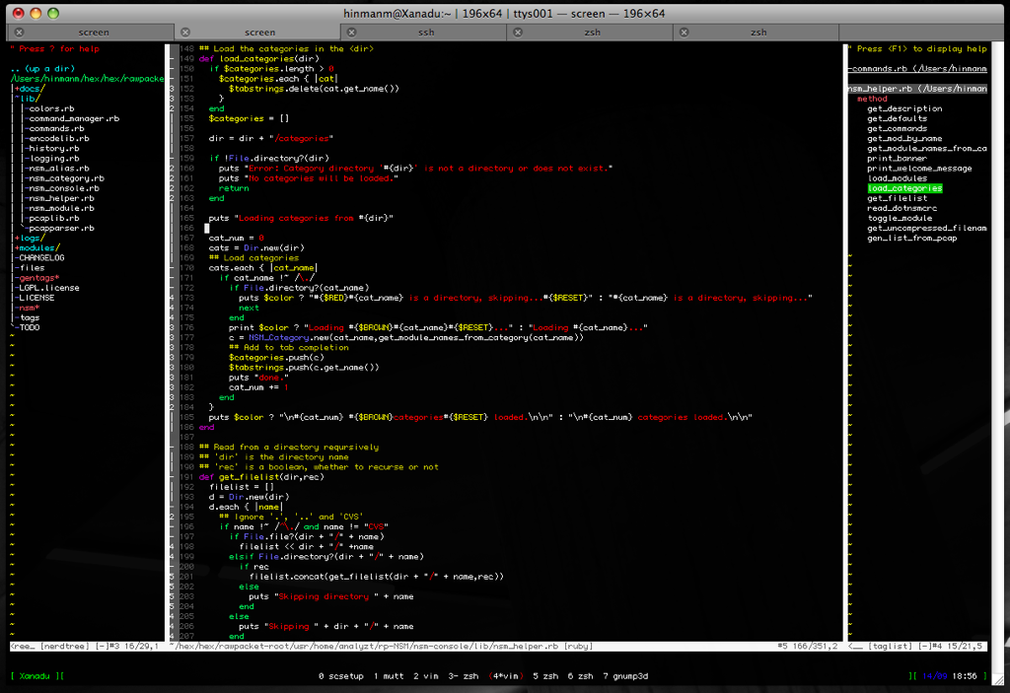
PROGRAMMING LANGUAGES
FRONT-END
BACK-END
WHAT USERS SEE AND INTERACT WITH
THE PROCESSES THAT ALLOW THE FRONT-END TO REACT, ADAPT, AND FUNCTION

Slide 10
PROGRAMMING LANGUAGES & TERMINOLOGY
<h1>programming languages</h1>
<h2>front-end web development</h2>
HTML: structure & content (what’s on the page?);
CSS: styling (how does it look?);
javascript: response & user activity (how do you interact?);
<h2>BACK-end web development</h2>
ruby on rails
python
php

Slide 11
REFRESH
☁
LET’S TAKE A BREAK.
5 MINUTES

Slide 12
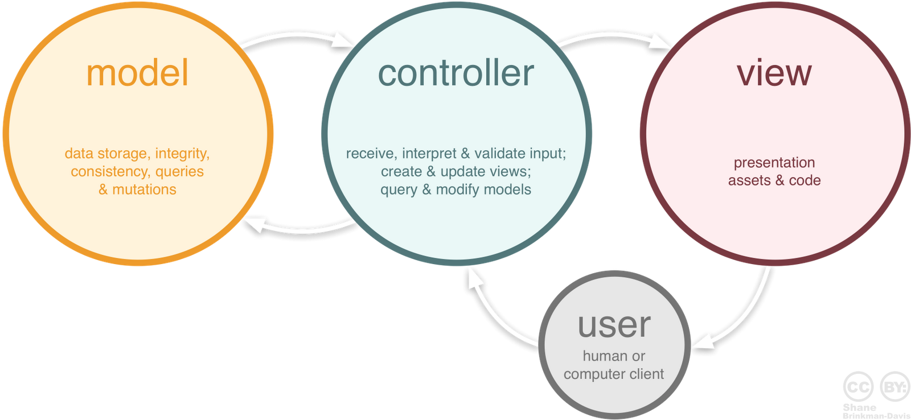
WEB-APPLICATION FRAMEWORK
MODEL-VIEW-CONTROLLER

Slide 13
MVC
MODEL
Core BUSINESS LOGIC
WRITTEN IN RUBY, PYTHON, JAVA, C#, C++, etc.
View
USER INTERFACE- ALL OF YOUR ASSETS and STYLE
HTML, CSS, JavaScript, etc.
CONTROLLER
CONNECTS the “FRONT END” and “BACKEND”
SAME LANGUAGE AS MODEL

Slide 14
DATABASES
HOW DOES A DATABASE ACTUALLY WORK?

Slide 15
DATABASES
What data does an e-commerce site need?
Customers:
Name
Address
City
State
Email
Phone
Orders:
Order Number
Date Purchased
Purchase Amount
Items Purchased
Shipping Date
Customer Name
Inventory:
SKU
Quantity Available
Price
Color
Brand
Description

Slide 16
CRUD
CREATE
ADDS A NEW RECORD IN THE DATABASE
READ
RETRIEVES A RECORD FROM THE DATABASE
UPDATE
Changes a record in the database
DELETE
DELETES a record in the database

Slide 17

HOW THE INTERNET WORKS
WHAT IS AN API ANYWAY?

Slide 18

APPLICATION PROGRAMMING INTERFACE
HTTP://
YOUR APP

Slide 19
HTTP Verbs – CRUD EQUIVALENT
POST
ADDS THE ENCLOSED DATA TO AN EXISTING RESOURCE
PUBLISH THIS PHOTO TO THE USERS ACCOUNT
GET
RETRIEVES a RESOURCE
GET all of the photos for the specified user
PUT
UPDATES THE SPECIFIED RESOURCE
CHANGE THE SPECIFIED PHOTO FOR THIS USER
DELETE
DELETES THE SPECIFIED RESOURCE
DELETES THE SPECIFIED PHOTO

Slide 20
BRINGING IT ALL BACK HOME
SO WHAT DO YOU do WITH ALL OF THIS INFORMATION?
WORK WITH YOUR DEVELOPERS!

Slide 21
BRINGING IT ALL BACK HOME
WORKING WITH DEVELOPERS
Should be brought in as early in the project as possible & have a sense of ownership.
Present the problem you’re trying to solve & solicit possible solutions.
As project progresses, develop requirements that the solution needs to address, but avoid prescribing how to do it.
Understand & remember that the developer is the expert in this area.

Slide 22
MAKING SMART TECHNOLOGY DECISIONS
BUILD
BUY
PARTNER
Do we have the in-house capability and expertise?
Is this part of our distinct competitive advantage?
Is the solution proprietary?
Can we maintain and improve this long term?
Is there no existing solution that satisfies our needs?
Can we build this cheaper or faster than an alternative?
Is there a known and trusted solution in the market?
Does this NOT play to our strengths our use our core capabilities?
Will building this distract from our core focus or prevent us from delivering more meaningful features?
Will we get to market significantly faster or less expensive?
Is it too risky to build?
Is there a trustworthy partner in the market?
Does their technology integrate with ours?
Does the partnership constitute a proprietary advantage?
Are we at high risk is the agreement is dissolved or the partner goes out of the business?
Are we good at technical partnerships?

Slide 23
WHAT WOULD YOU DO?
or
BUILD
BUY/PARTNER
Payments Square
Maps/Location Google Maps
CRM Salesforce
Business Data Foursquare
A/B Testing Optimzely

